Slide 1
Forest Cover Prediction
Group-7
Akhil Bharadwaj
Yashwant Bhaidkar

Slide 2
About forest cover type prediction
Accurate prediction of forest cover types can provide valuable information for land managers, conservationists, and scientists who are interested in understanding and managing forest ecosystems.
For example, accurate predictions of forest cover types can help identify areas vulnerable to wildfires, predict the impact of climate change on forest ecosystems, and identify areas suitable for timber harvesting or recreational use.
The motivation behind using the forest cover type prediction dataset is to develop and evaluate machine learning models for predicting forest cover types in a real-world setting.

Slide 3
About the dataset
The forest cover type prediction dataset is a widely used benchmark dataset in machine learning and remote sensing applications.
It was created at the GIS Program at Colorado State University. The dataset was obtained from the UCI repository. Link to download the dataset:- (https://archive.ics.uci.edu/ml/datasets/covertype).
The goal of this project is to predict the forest cover type (one of seven types) based on the given attributes. It has been used in numerous studies and competitions to evaluate the performance of various machine-learning algorithms and techniques.
This dataset has been used in numerous studies and competitions, leading to the development of new machine-learning models and techniques that can be applied to similar problems in other domains.

Slide 4
Dataset Description
The dataset contains information about the forest cover type for 30-meter square cells in four wilderness areas located in the Roosevelt National Forest of northern Colorado. The areas are located at elevations ranging from 2,596 to 3,929 meters and include a diverse range of tree species and vegetation types.
The dataset consists of 581,012 instances with 54 attributes, including 10 quantitative variables and 44 binary variables. The quantitative variables include elevation, slope, aspect, horizontal distance to water, and other terrain variables. The binary variables include wilderness area, soil type, and tree type.

Slide 5
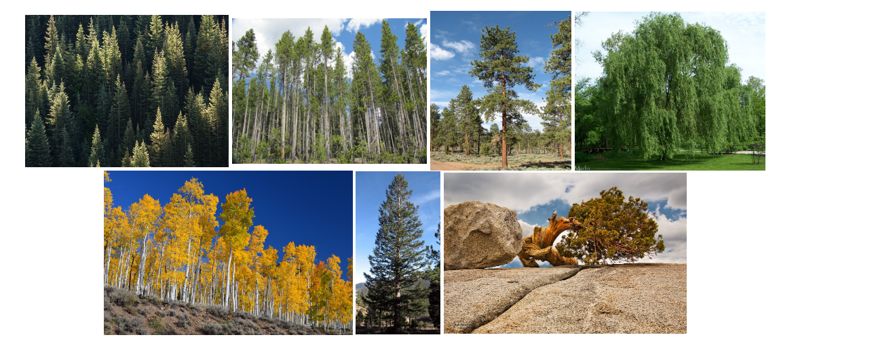
Forest cover types
Spruce/Fir
Lodgepole Pine
Ponderosa Pine
Cottonwood/Willow
Aspen
Douglas-fir
Krummholz

Slide 6
Feature Description
Name | Data Type | Measurement | Description
Elevation | quantitative | meters | Elevation in meters
Aspect | quantitative | azimuth | Aspect in degrees azimuth
Slope | quantitative | degrees | Slope in degrees
Horizontal_Distance_To_Hydrology | quantitative | meters | Horz. Dist. to nearest surface water features
Vertical_Distance_To_Hydrology | quantitative | meters | Vert. Dist. to nearest surface water features
Horizontal_Distance_To_Roadways | quantitative | meters | Horz. Dist. to the nearest roadway
Hillshade_9am | quantitative | Hillshade index at 9 am | summer solstice
Hillshade_Noon | quantitative | Hillshade index at noon | summer solstice
Hillshade_3pm | quantitative | Hillshade index at 3 pm | summer solstice
Horizontal_Distance_To_Fire_Points | quantitative | meters | Horz. Dist. to nearest wildfire ignition points
Wilderness_Area (4 binary columns) | qualitative | 0 (absence) or 1 (presence) | Wilderness area designation
Soil_Type (40 binary columns) | qualitative | 0 (absence) or 1 (presence) | Soil Type designation
Cover_Type (7 types) | integer | 1 to 7 | Forest Cover Type Designation

Slide 7
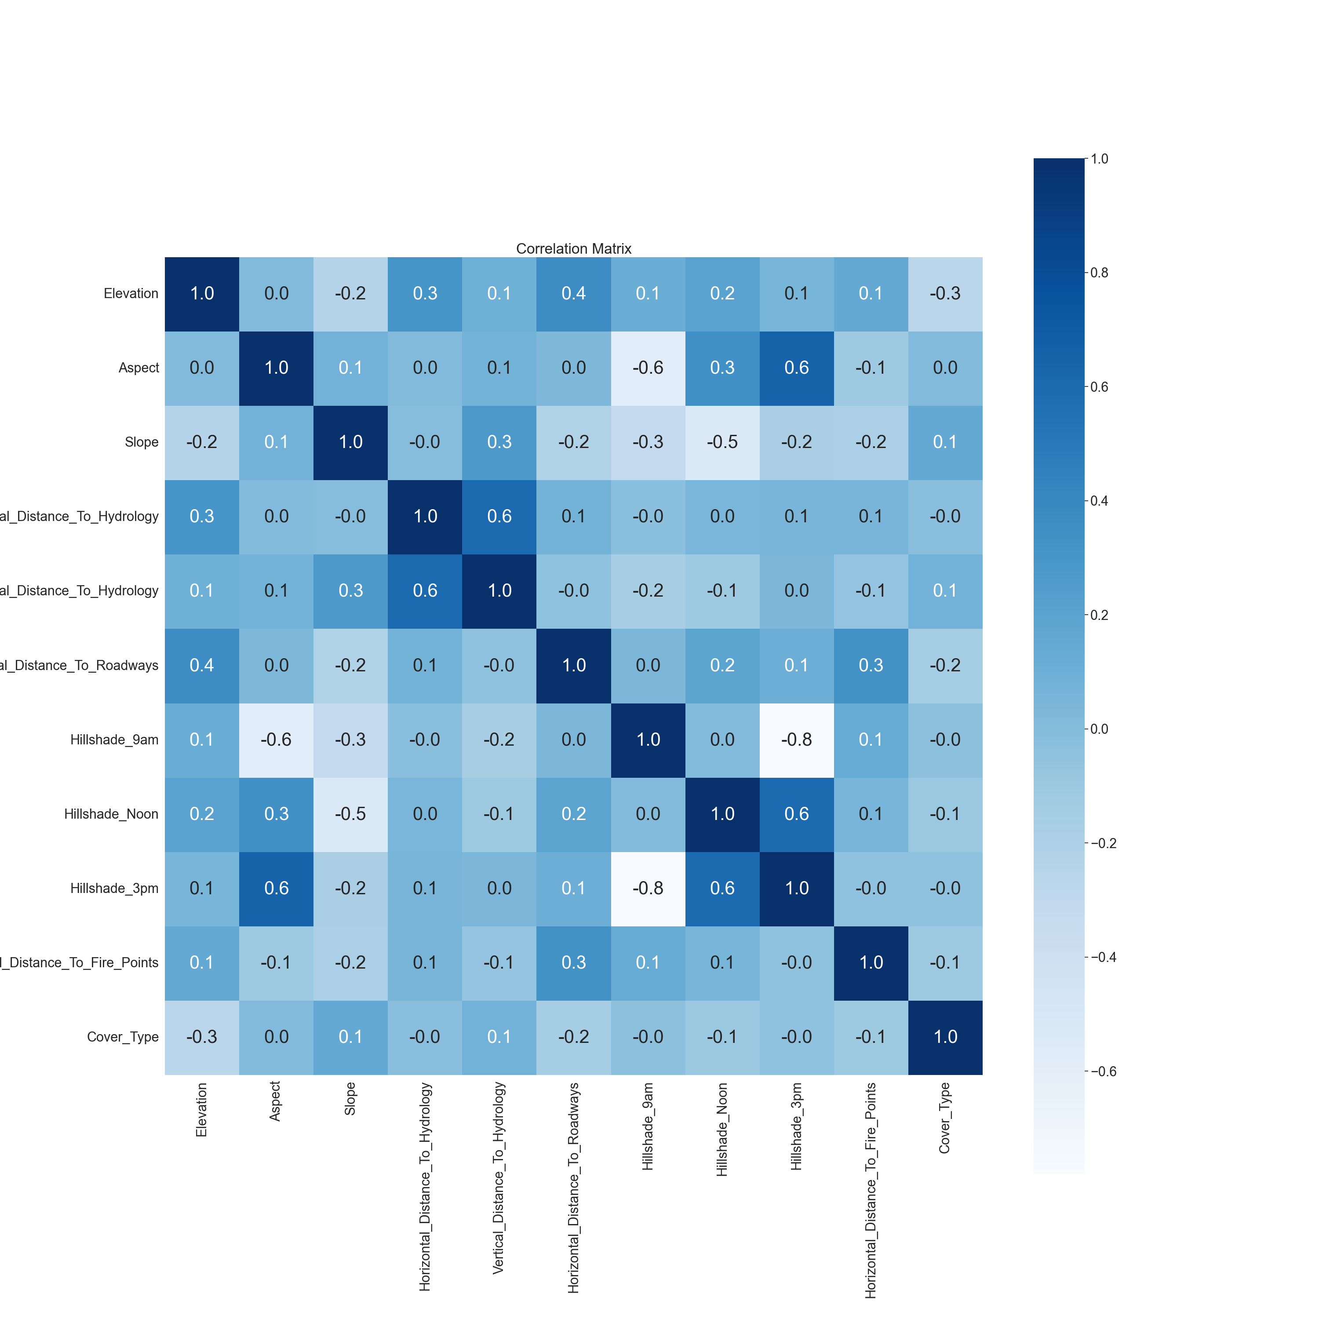
Correlation plot

Slide 8
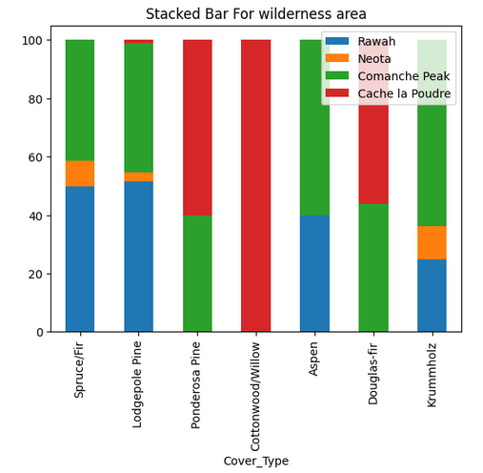
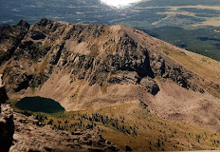
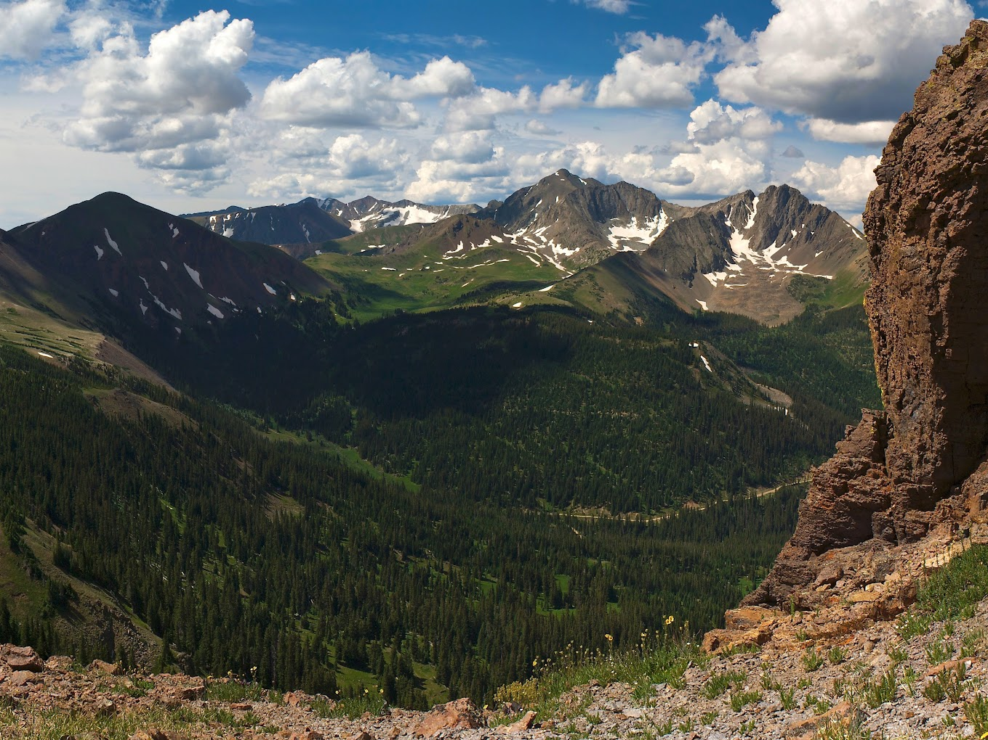
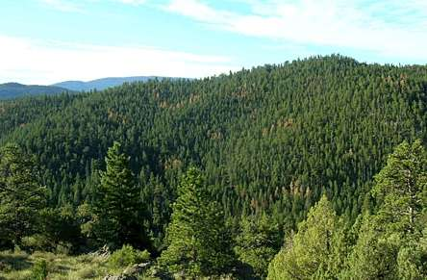
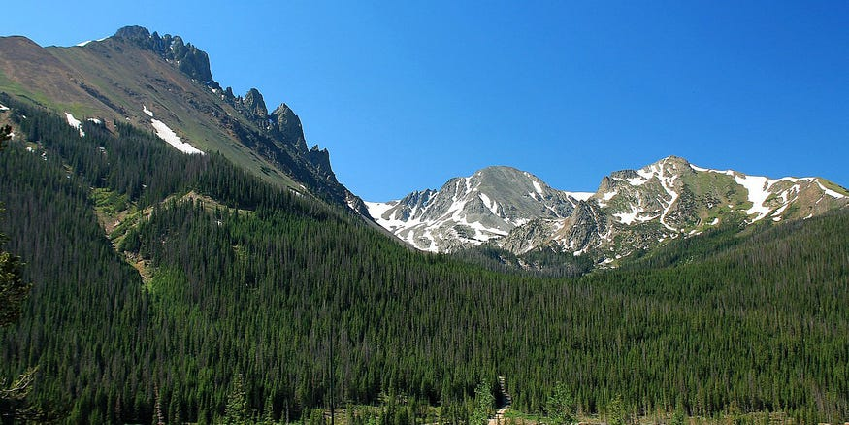
EDA: Wilderness Area
Rawah
Neota
Comanche Peak
Cache la Poudre

Slide 9
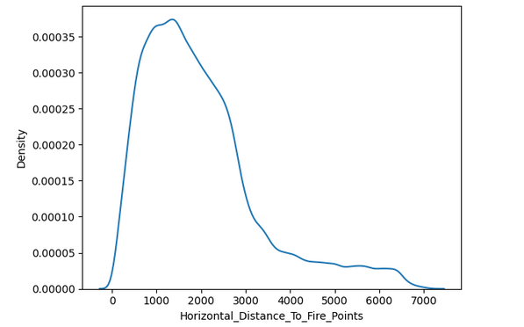
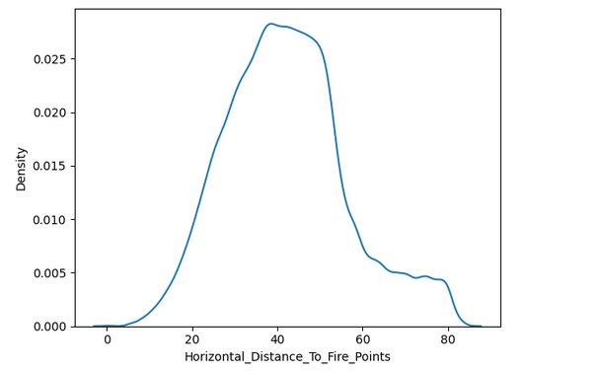
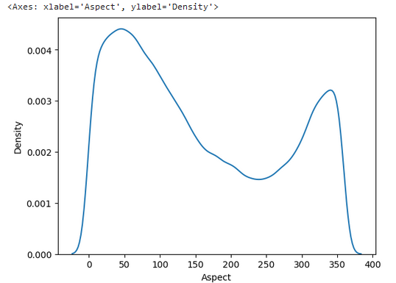
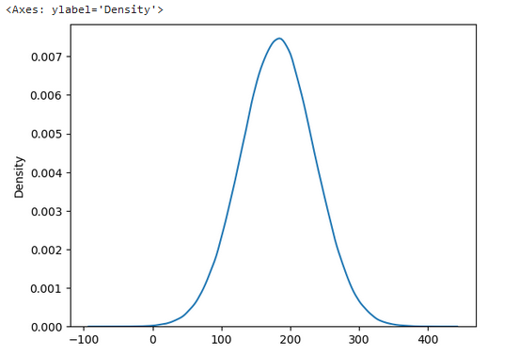
Feature Engineering on Numerical and Categorical feature
Transformation of right-skewed feature to approximate normal
Categorical features | Number of features | Encoding Type
Wilderness area | 4 | One hot Encoding
Soil types Categories | 40 | One hot Encoding
Sqrt Transform
Transformation of bimodal feature to normal
For other numerical features elevation,slope,horizontal and vertical distance to hydrology, we applied standard scaling
Gaussian Mixture

Slide 10
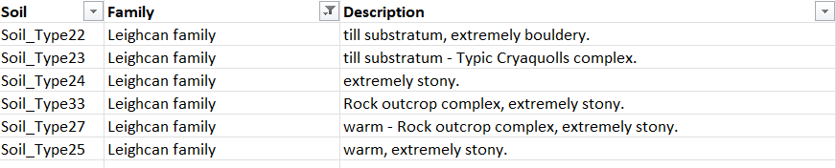
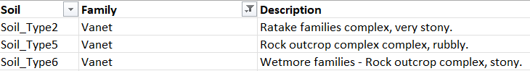
Observations about the soil Features
Some of the soil types are sharing the same soil Family

Slide 11
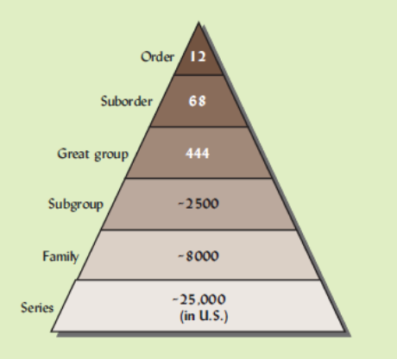
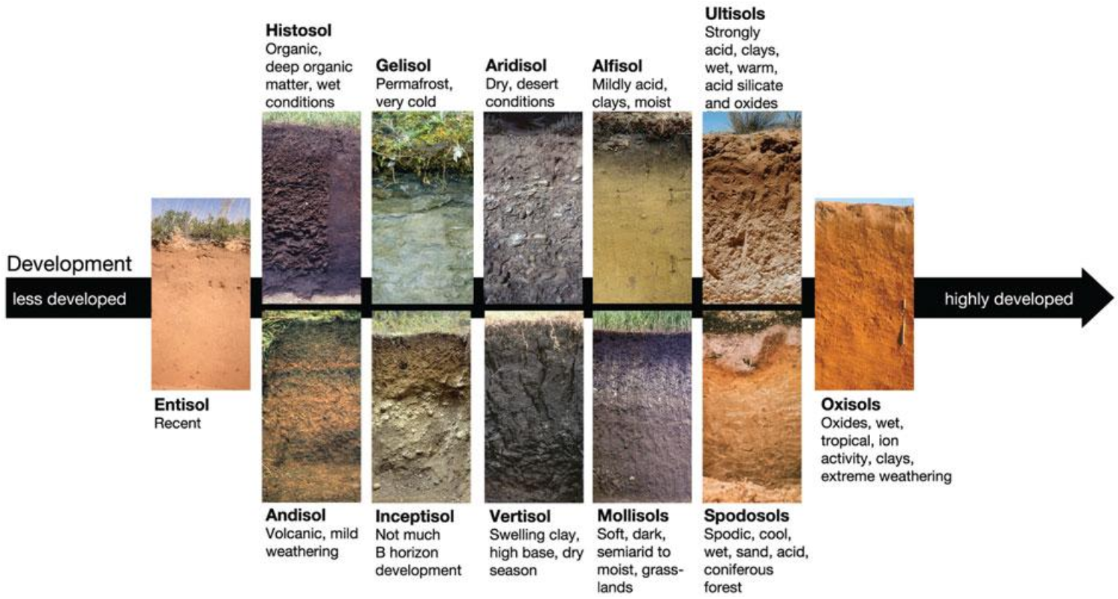
Feature Engineering – Soil Orders

Slide 12
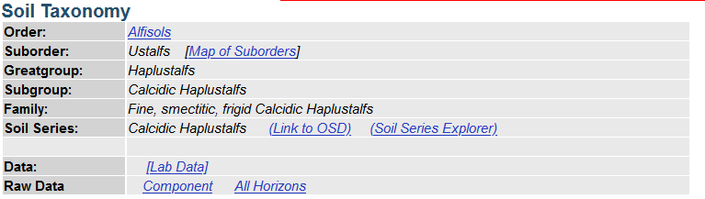
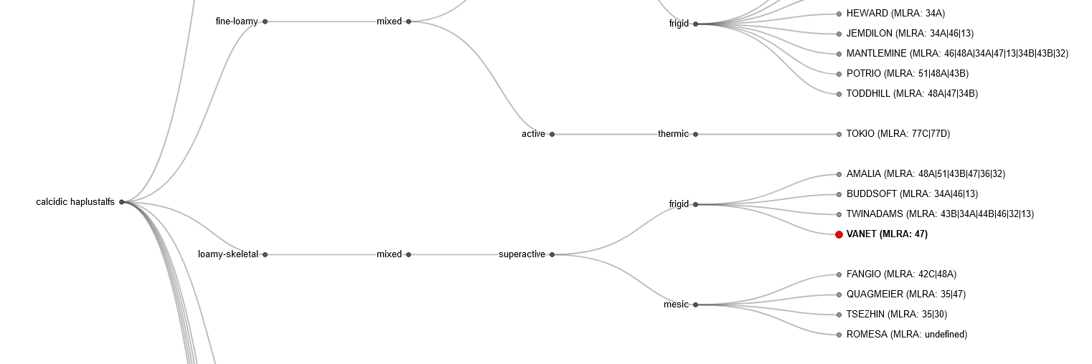
Feature Engineering – Soil Orders
Results From soil data explorer
Soil order and family mapping on soilweb.com

Slide 13
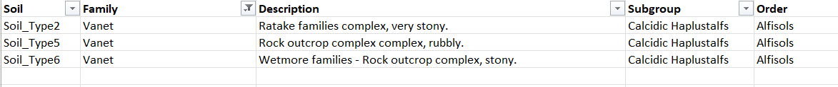
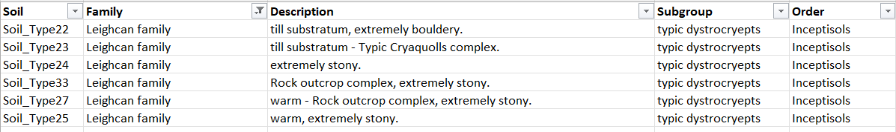
Feature Engineering – Soil Orders
Order mapping for Vanet Soil Family
Order mapping for Leighcan Soil Family​

Slide 14
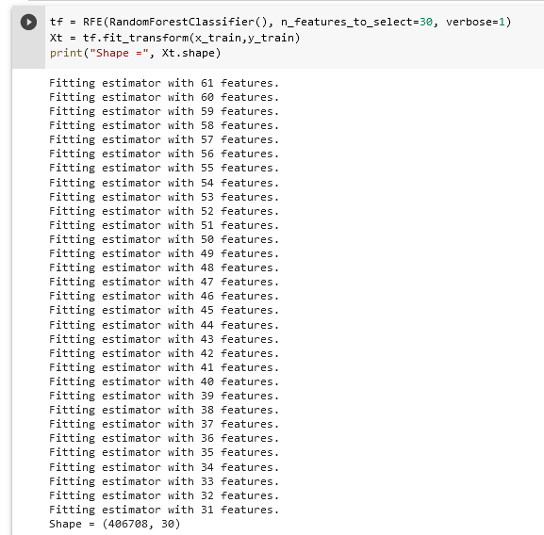
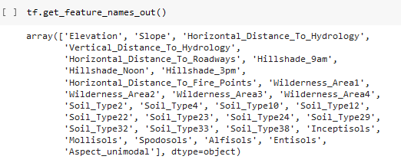
Feature selection - Recursive feature elimination
Important Features based on RFE feature importance

Slide 15
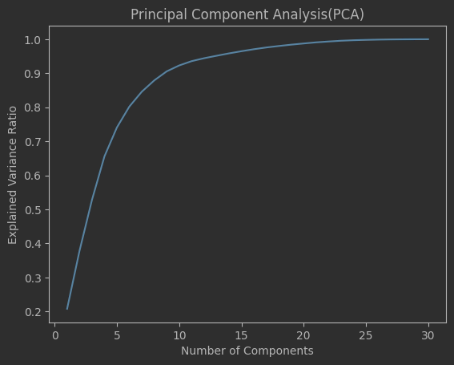
Principal Component Analysis (PCA)

Slide 16
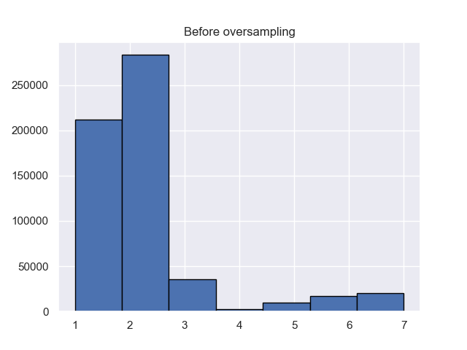
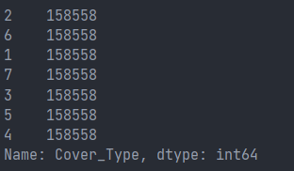
EDA: Target class distribution
After oversampling using SMOTE

Slide 17
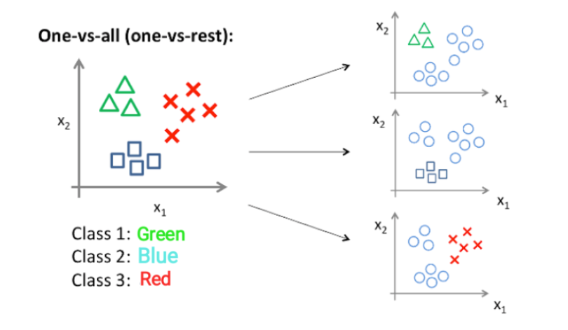
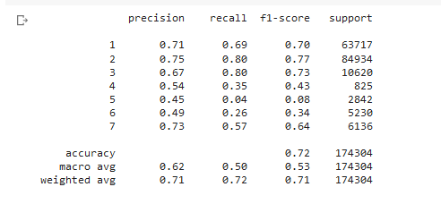
Baseline Model – Logistic Regression for Multiclass
Approach
LR model results on test data

Slide 18
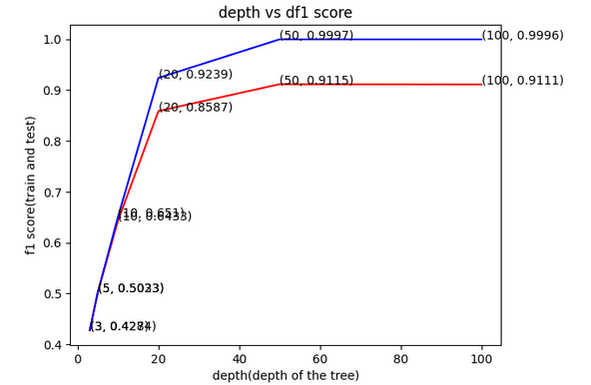
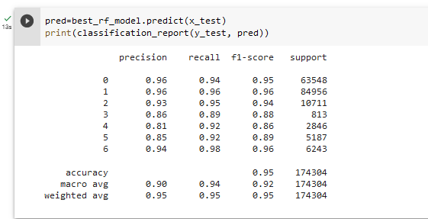
Random Forest classifier
Hyperparameter tuning
RF model results on test data

Slide 19
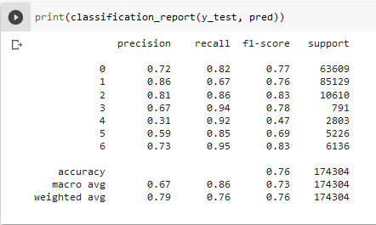
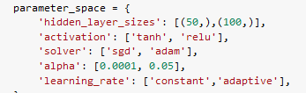
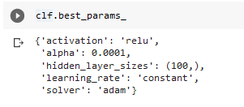
MLP Classifier
MLP Classifier model results on test data
MLP Classifier best hyper parameters

Slide 20
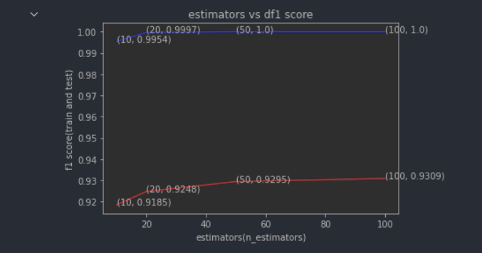
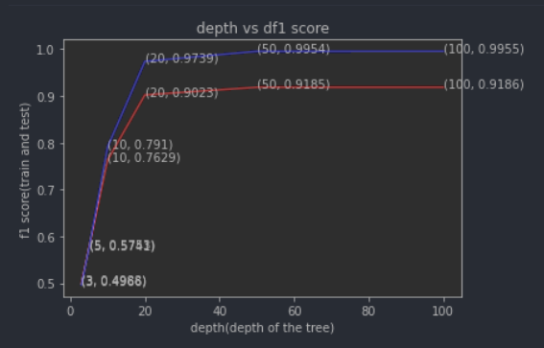
XGBoost classifier
Best Parameters:-
xgbc = XGBClassifier(n_estimators = 100, depth = 100)
Hyperparameter tuning
Hyperparameter Tuning for estimators
Hyperparameter Tuning for depth

Slide 21
Model Comparison after fine-tuning
ML model | F1 score (macro) on test set
Logistic Regression (multi-class) - Baseline | 0.53
MLP Classifier | 0.73
Random Forest Classifier | 0.92
XGBoost classifier | 0.93

Slide 22
Summary and Conclusions
Feature engineering and hyperparameter tuning improved results for the Random Forest Classifier and XGBoost Classifier by 1% and 1.2% respectively.
Soil order type features were also considered important features in feature selection.
Some other features like weather conditions and geographical information like location could help us in improving our results further.

Slide 23
Thank you

